Slide 1

A
Project
On
WHEELS ON DEMAND
PRESENTED BY: 1. Aadarsh (2502459200101)
2. Sanya (250245920076)
3. Dnyaneshwari (250245920019)
4. Ishank (250245920034)
5. Sudhanshu (250245920085)
.

Slide 2



CONTENT
INTRODUCTION
PROJECT OVERVIEW
PROBLEM STATEMENT
OBJECTIVE
MAJOR OUTCOMES
SOFTWARE REQUIREMENTS
UML DIAGRAMS
SCOPE OF APPLICATION
CONCLUSION

Slide 3
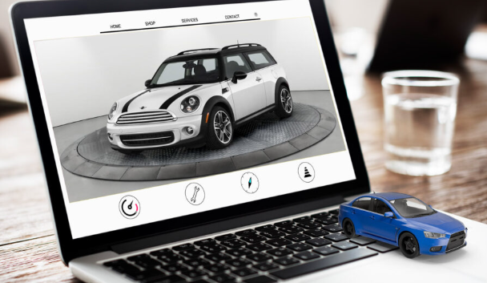


INTRODUCTION
Wheels on Demand is an online platform that allows users to buy and sell used cars online easily. It connects car buyers and sellers, provides car details, pricing, and allows smooth transactions from the comfort of home. The project aims to make car trading faster, transparent, and hassle-free.

Slide 4
PROJECT OVERVIEW
Wheels on Demand is an online car marketplace that simplifies the process of buying and selling used car. The system allows users to register, list their vehicles for sale, browse available cars, compare prices, and make secure purchases or sales.
Users can upload a photo of an automobile or browse the available cars. Once they've found a suitable car, they may buy through the platform and pay online.
Enables buyers to search, filter, and compare cars based on make, model, price, and location.
The system combines convenience, simplicity, and smart features to deliver a superior and hassle-free car purchase or car sell experience for every user.

Slide 5
problem Statement
The traditional process of buying and selling cars is often time-consuming, lacks transparency, and involves multiple middlemen. Customers face challenges like unreliable pricing, limited car information, and lengthy paperwork. There is a need for a digital platform that provides a fast, secure, and trustworthy way to buy and sell used cars online with complete vehicle details, fair pricing, and smooth documentation.

Slide 6
objective
Enable Easy User Access & Registration
Provide Smart Car Search
Streamline Online Booking and Payments
Simple And Efficient Administration Portal

Slide 7
MAJOR OUTCOME
End-to-End Online Car Sell & Purchase Platform
Secure Booking and Payment Workflow
Efficient Admin-Portal For Application Management
Efficient Complaint & Review Handling
Improved User Convenience and Experience

Slide 8
software requirements
React.js: For building the responsive user interface
MySQL: To store all application data of users, cars, bookings, etc.
MS .Net : Used to Build Backend development, Rest API’s & Web Service
API Testing Tools: Postman
Deployment Tools: AWS , Render

Slide 9
UML Diagrams
The slides that follow present detailed UML diagrams that provide clear insights into the application's workflow, system architecture, construction process, role-based functionalities, and database structure—offering a complete understanding of how each component operates and interacts to ensure that the entire application runs smoothly and efficiently.
ER Diagram
Class Diagram
Use Case Diagram
Activity Diagram
Sequence Diagram
Data Flow Diagram

Slide 10
ER Diagram

Slide 11
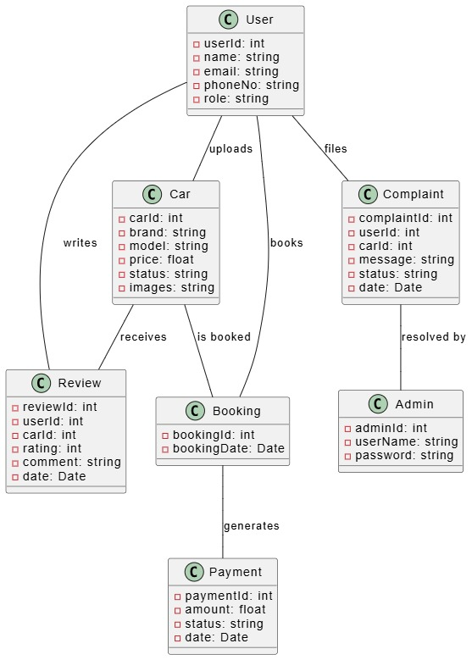
class Diagram

Slide 12
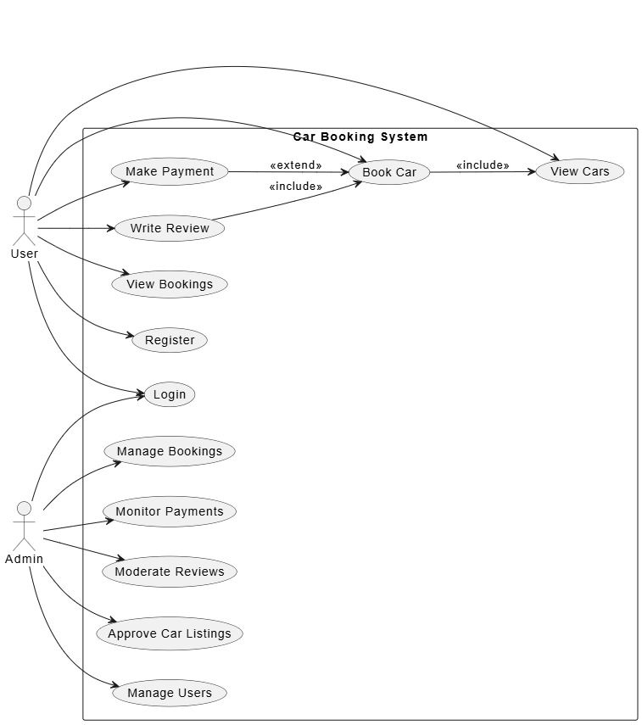
use case Diagram

Slide 13
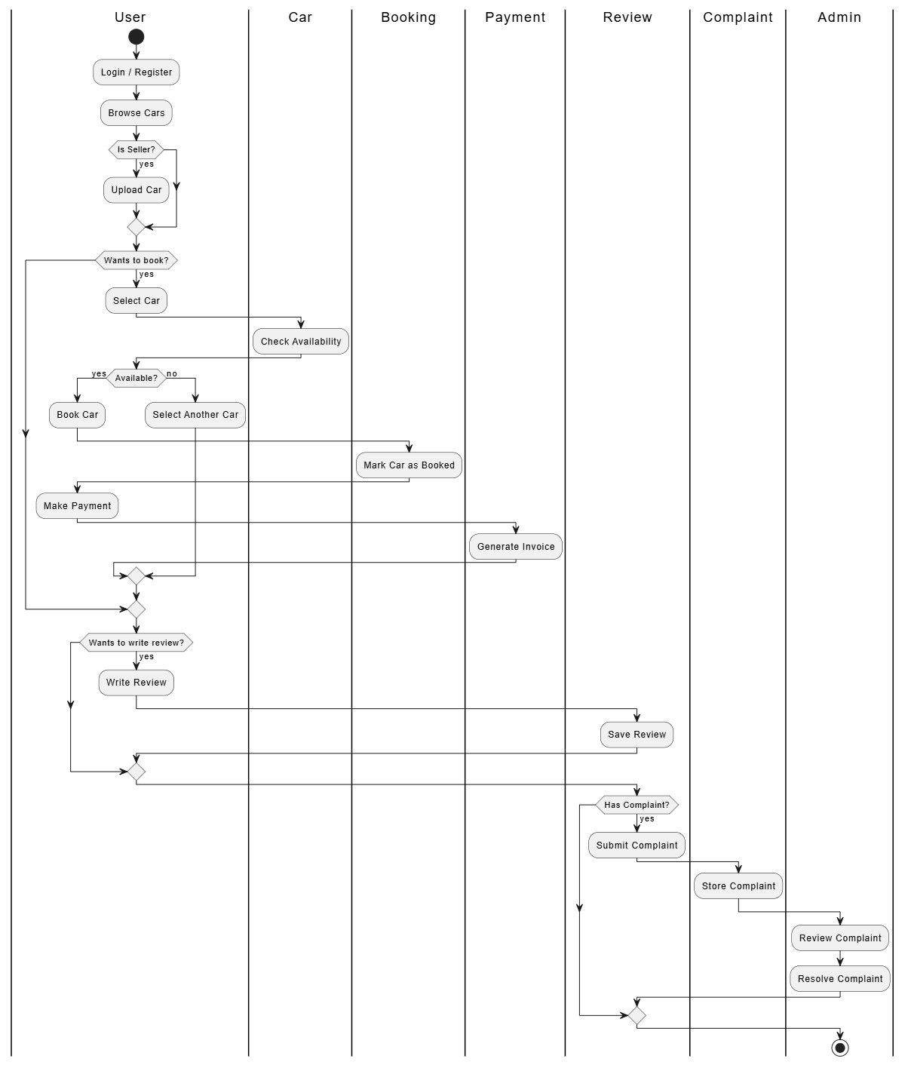
Activity Diagram

Slide 14
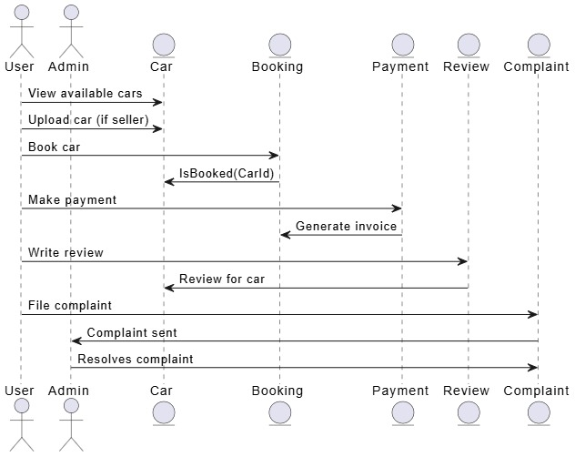
Sequence Diagram

Slide 15
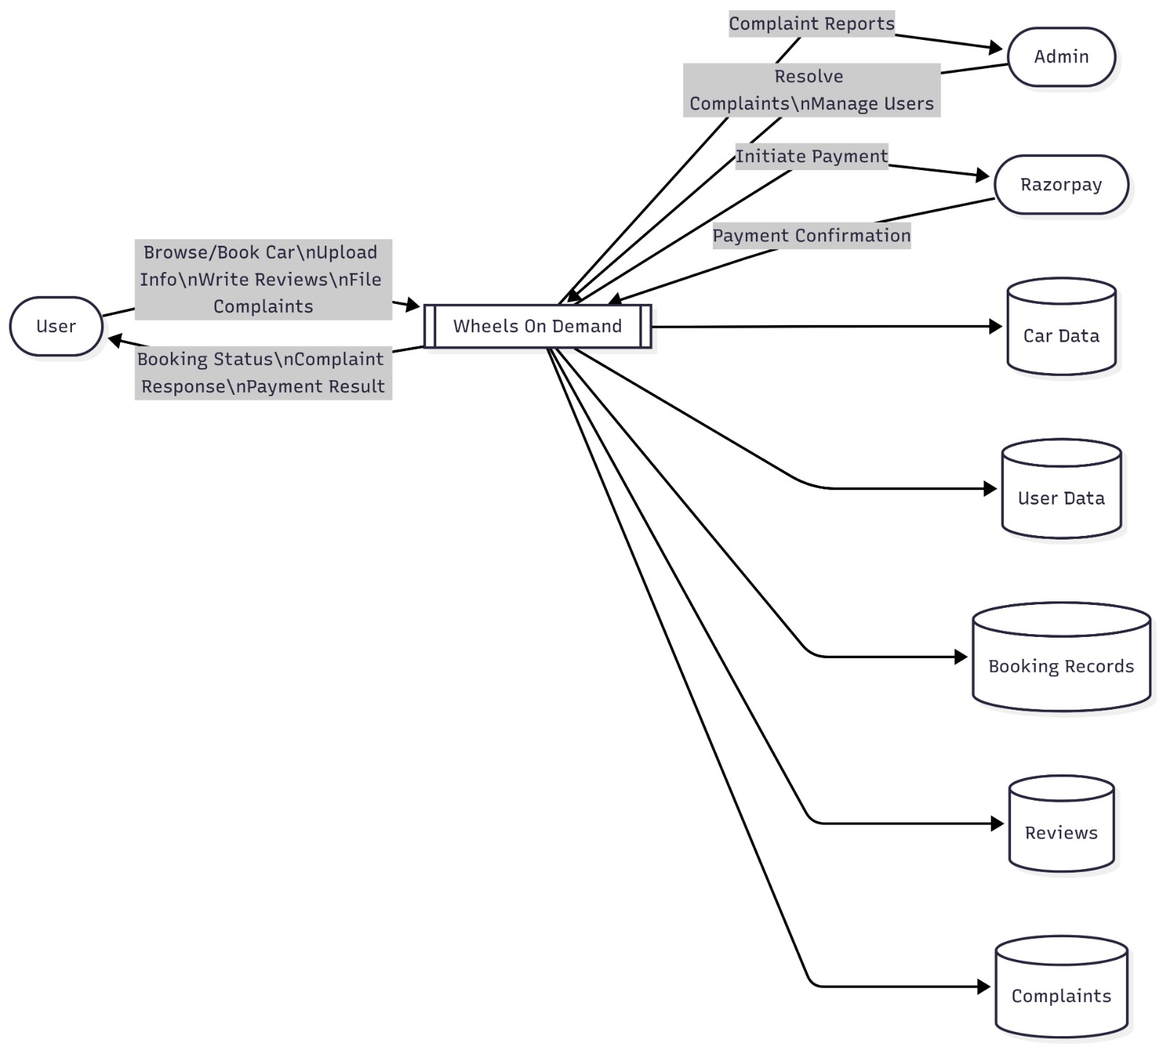
DATA flow Diagram

Slide 16
FUTURE scope
.
Mobile App Launch for easier access and faster bookings.AI-Based Car Suggestions.
Image-Based Car Matching Feature
Use AI to recommend cars based on user preferences and past activity.
EV Car Integration to add electric vehicles with options for charging station info and bookings.

Slide 17

conclusion
Wheels on Demand offers a modern, user-friendly solution to the challenges of buying and selling used cars. By bringing the entire process online—from listing to final transaction—it ensures convenience, and efficiency. This platform not only saves time but also builds trust between buyers and sellers, making car trading easier and more accessible for everyone.

Slide 18

THANK YOU!

